Slide 1
Analyzing large-scale real-world data in supercomputing environments using modern analytics engines
-Rishabh Kapoor

Slide 2
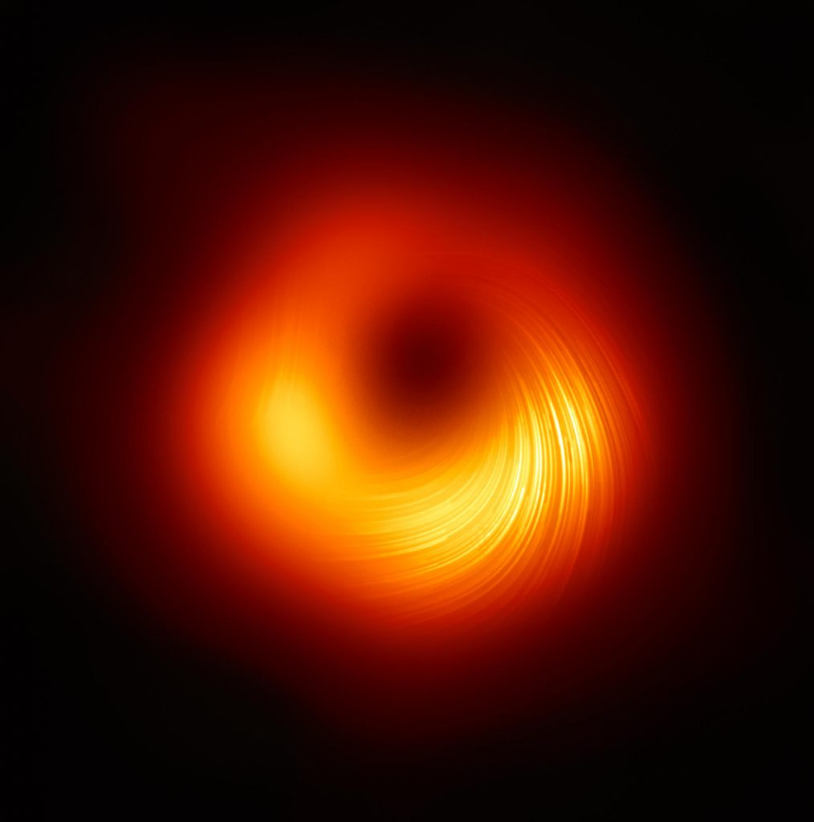
Astronomical Dataset

Slide 3
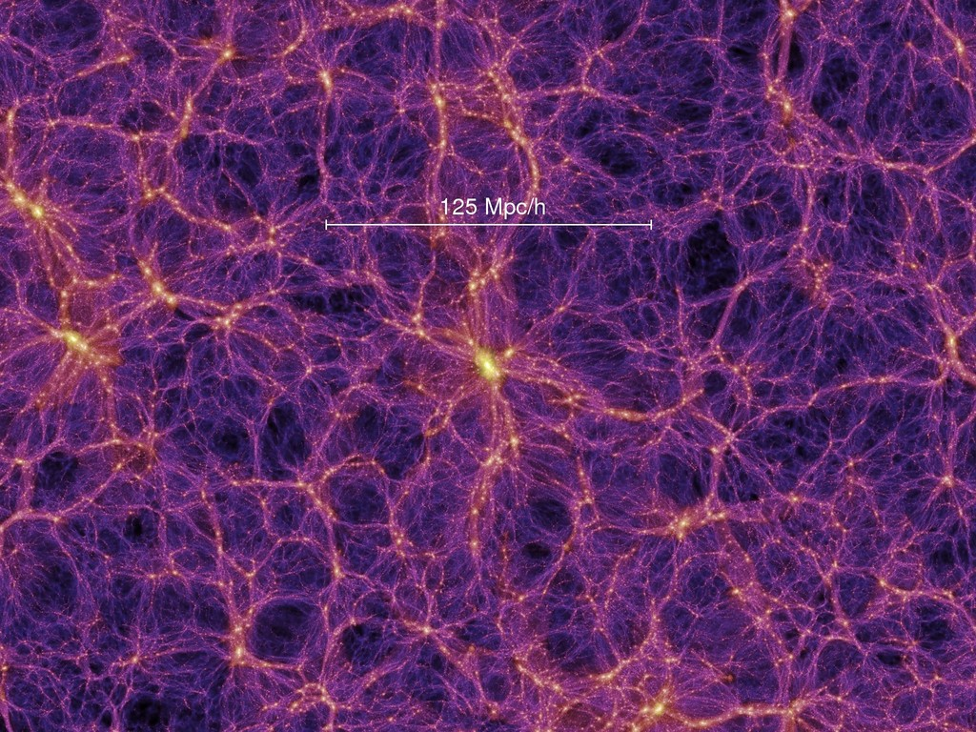
Millennium Project
structure distribution in the universe based on cosmological models.

Slide 4
Tech Stack
Python
Hadoop -> high latency but will be a better option for batch processing.

